Slide 1
United International University
Computer Networks Laboratory
CSE 324
FaceBook Group: www.facebook.com/groups/CN324
OR,
Computer Networks Lab (CISCO)
Azim Uddin Chowdhury
UIU CISCO Networking Academy
Phone: 01741125920
Mail: azim.cy@gmail.com

Slide 2
Host Port/ Interface Type & Data Speed:
Port Type | Port Speed (Mbps)
Ethernet | 0 to 10Mbps
Fast Ethernet | 0 to 100Mbps
Gigabit Ethernet | 100Mbps to 10Gbps

Slide 3
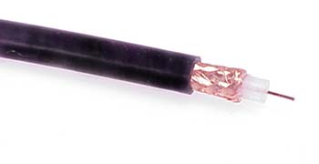
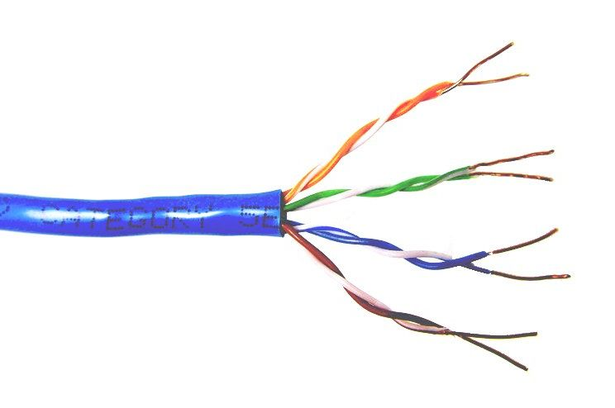
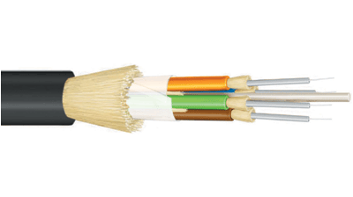
Common network cable types
Coaxial cable
Unshielded Twisted Pair
Fiber optic

Slide 4
UTP categories
Category 1 | Voice only (Telephone)
Category 2 | Data to 4 Mbps (Localtalk)
Category 3 | Data to 10Mbps (Ethernet)
Category 4 | Data to 20Mbps (Token ring)
Category 5 Category 5e | Data to 100Mbps (Fast Ethernet) Data to 1000Mbps (Gigabit Ethernet)
Category 6 | Data to 2500Mbps (Gigabit Ethernet)

Slide 5
Ethernet Cable (Host to Host):
Copper Straight through (Different Group)
Copper Crossover Cable (Same Group)
OSI Layer | Device
Application Layer | PC, Server, Printer
Presentation Layer
Session Layer
Transport Layer
Network Layer | Router
Data Link Layer | Switch
Physical Layer | HUB
_._._._

Slide 6
Internet Protocol (IP)
Type of IP:
→ IPv4: Internet Protocol version 4
IPv4 Length: 32 bits
→ IPv6: Internet Protocol version 6
IPv6 Length: 128 bits
IPv4 : Dotted Decimal Address
Ex. 192.168.10.0/24
IPv6 : Hexadecimal Address separated by colons (:)
Ex. 2001:0db8:85a3:0000:0000:8a2e:0370:7334/64
Notes:
Section 1.2.1.5

Slide 7
Internet Protocol version 4 (IPv4) : Public
Class | Start IP | End IP | Network Part | Host Part | Default Subnet Mask
A | 0.0.0.0 | 127.255.255.255 | 8 | 24 | 255.0.0.0
B | 128.0.0.0 | 191.255.255.255 | 16 | 16 | 255.255.0.0
C | 192.0.0.0 | 223.255.255.255 | 24 | 8 | 255.255.255.0
D | 224. 0.0.0 | 239.255.255.255 | Reserved for Multicasting
E | 240.0.0.0 | 255. 255.255.254 | Experimental; used for research
Notes:
Section 1.2.1.5

Slide 8
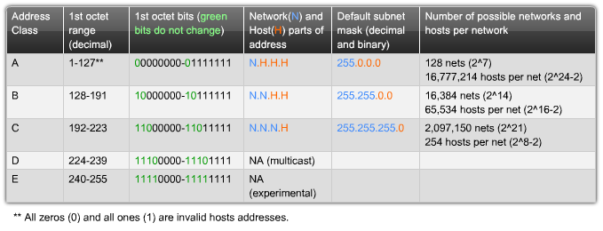
Internet Protocol version 4 (IPv4) : Public
Special Use:
Network Address: All Host bits are ‘0’
Broadcast Address: All Host bits are ‘1’
Loopback Address:
IPv4: 127.0.0.1/8 & IPv6: ::1
Link Local Address:
IPv4: 169.254.0.1/16 & IPv6: FE80::1
Notes:
Section 1.2.1.5

Slide 9
Internet Protocol version 4 (IPv4) : Private
Class | Start IP | End IP | Network Part | Host Part | Default Subnet Mask
A | 10.0.0.0 | 10.255.255.255 | 8 | 24 | 255.0.0.0
B | 172.16.0.0 | 172.31.255.255 | 16 | 16 | 255.255.0.0
C | 192.168.0.0 | 192.168.255.255 | 24 | 8 | 255.255.255.0
IP Address:
Network Address: All Host bits are ‘0’
Subnet Mask: All Network bits are ‘1’
Broadcast Address: All Host bits are ‘1’
Notes:
Section 1.2.1.5

Slide 10
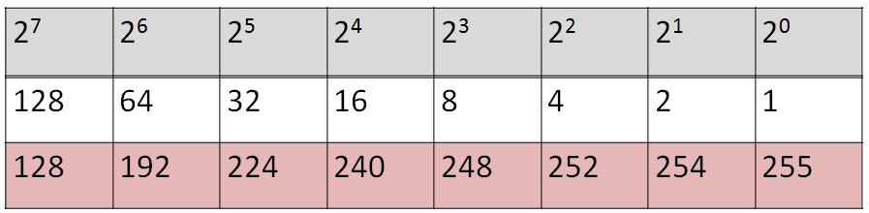
Internet Protocol version 4 (IPv4)
Notes:
Section 1.2.1.5

